Slide 1
Project Name: SQL Data Analysis.

Slide 2
Project Summary :
This is a data analysis project using sql in which I have been given a music dataset. Which consists of 11 tables. The tables are 1. Album , 2.Artist , 3.customer , 4.employee , 5. Genre , 6.Invoice , 7.invoice_line, 8. media_type , 9. playlist , 10. playlist_track, 11.track
I have been given few questions that I have to answer by exploring dataset.

Slide 3
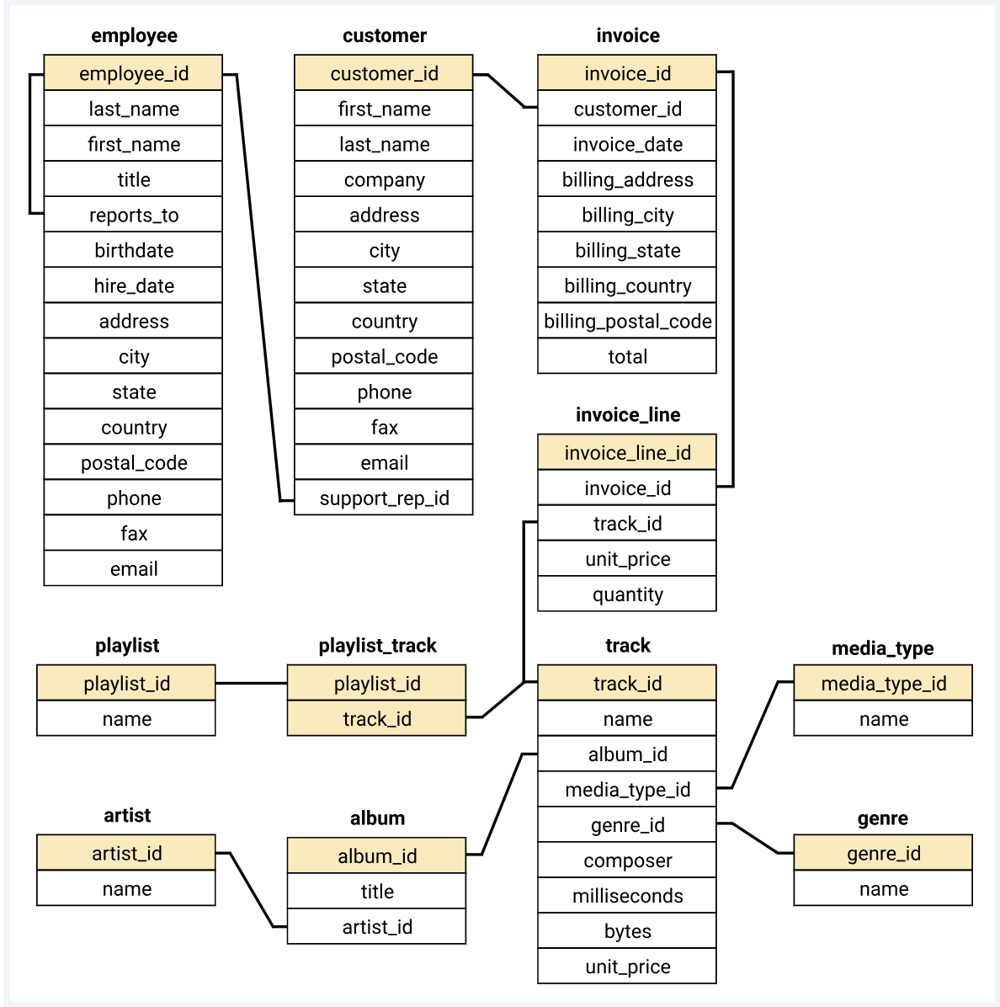
Music Dataset Schema :

Slide 4
Music Dataset Questionnaire :

Slide 5
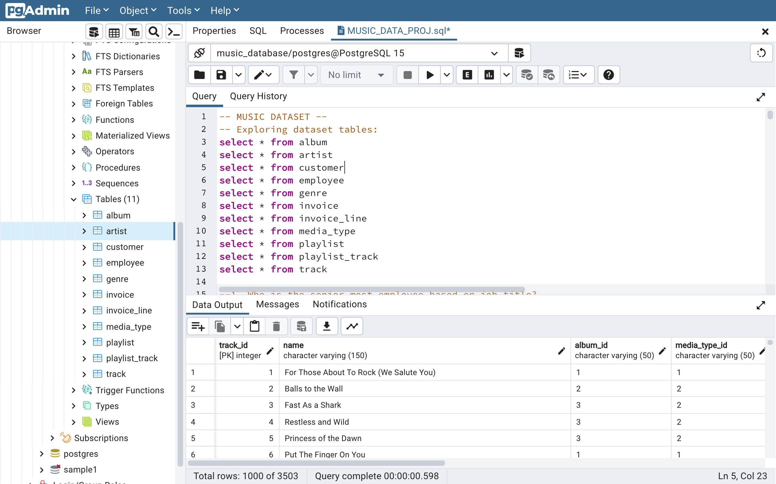
Exploring Dataset Tables:

Slide 6
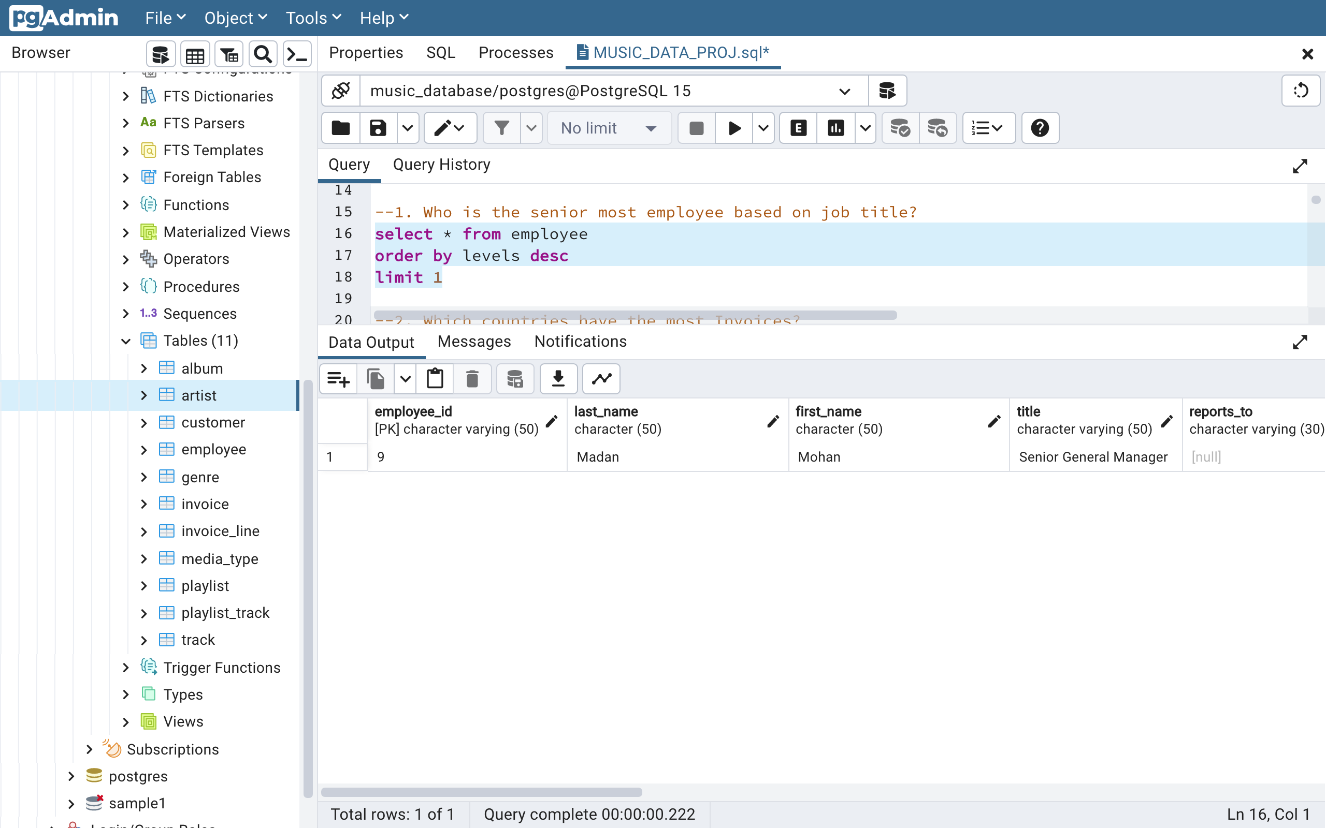
Q1. Who is the senior most employee based on job title?
Answer1. The above query shows that Mohan Madan is the senior most employee.

Slide 7
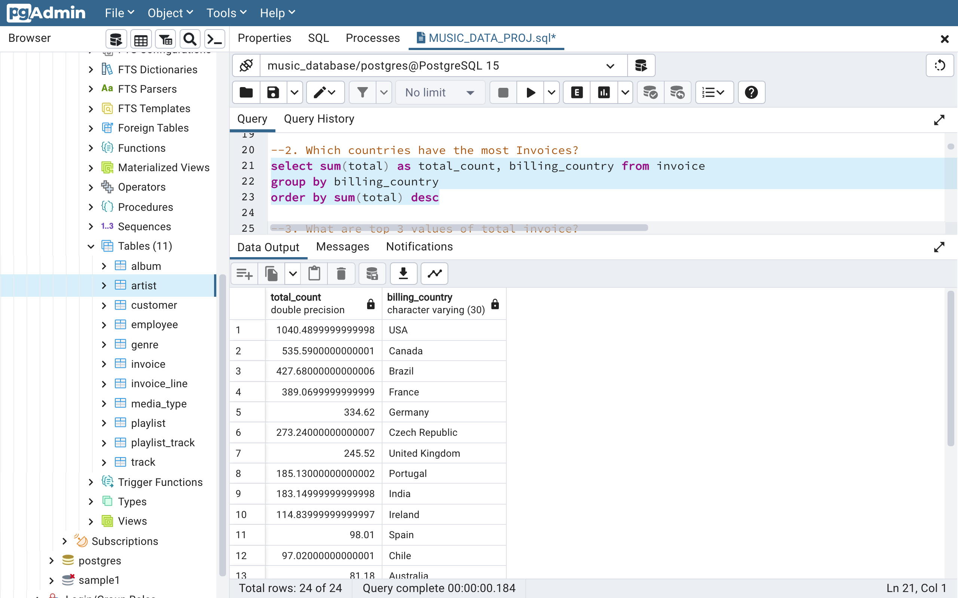
Q2. Which countries have the most Invoices?
Answer2. The above query shows the countries with most number of invoices.

Slide 8
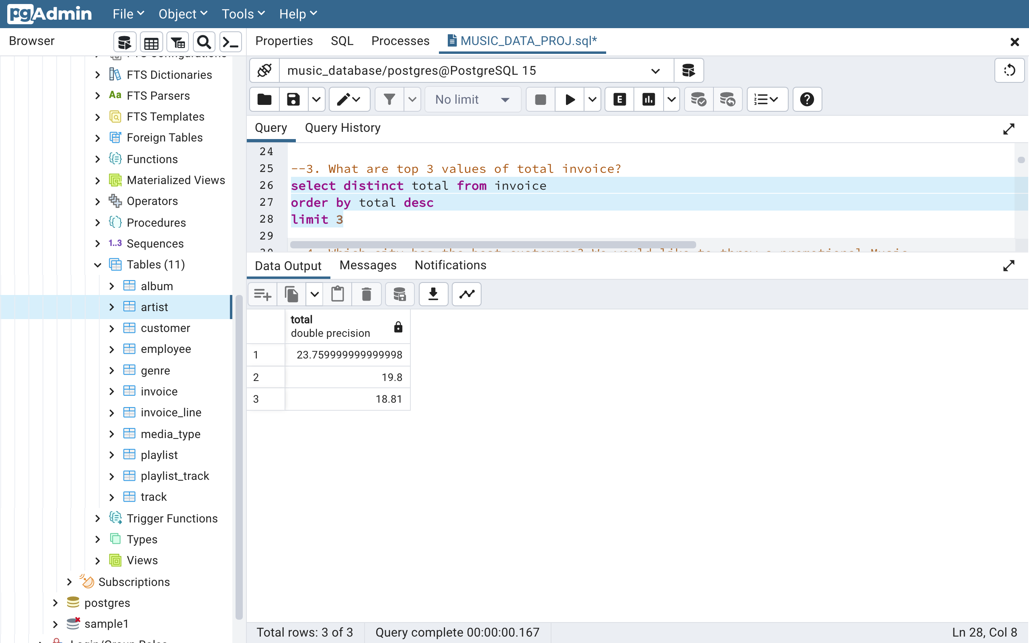
Q3. What are top 3 values of total invoice?
Answer3. The above query shows the top 3 values of total invoices.

Slide 9
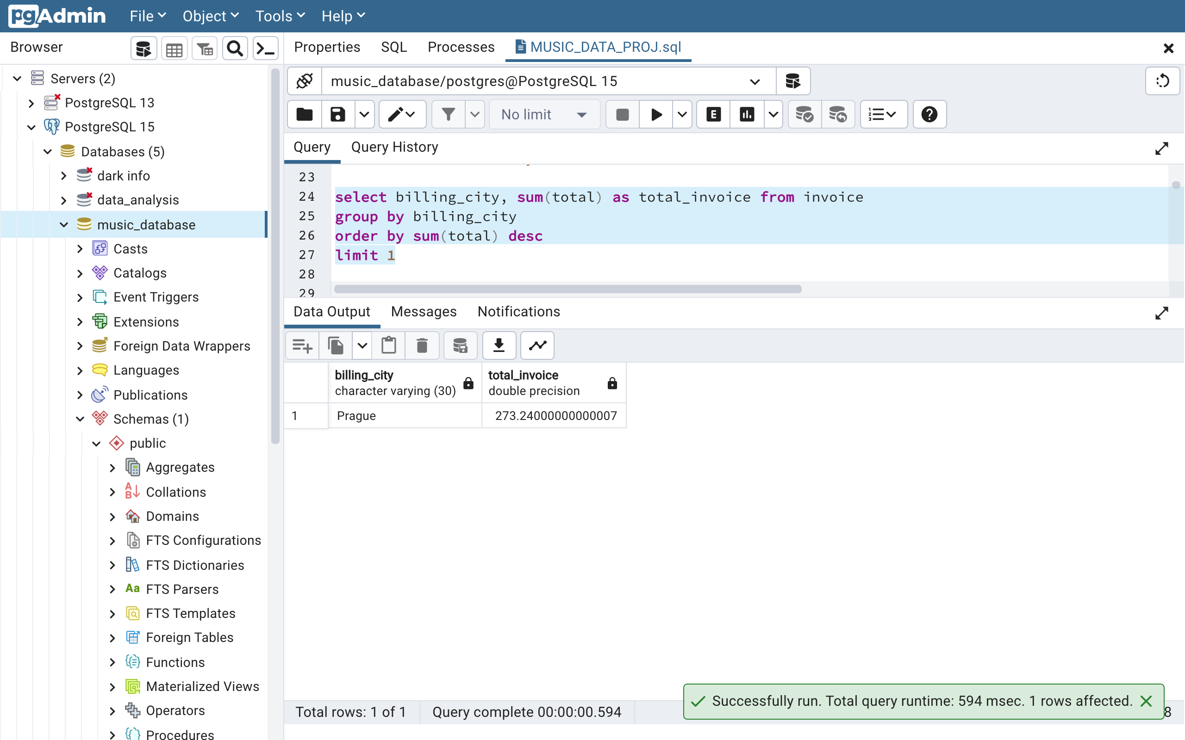
Q4. Which city has the best customers? We would like to throw a promotional Music
festival in the city we made the most money. Write a query that returns one city that has the highest sum of invoice totals. Return both the city name & sum of all invoice totals
Answer4. The above query shows that Prague has the best customers.

Slide 10
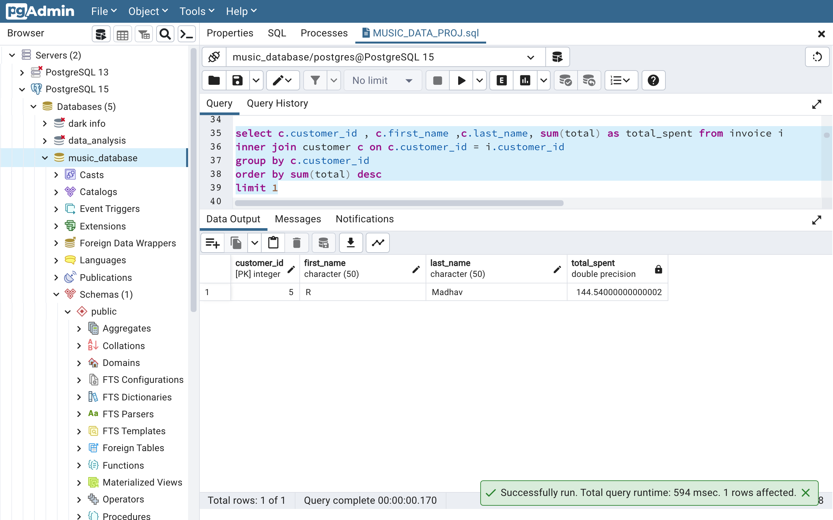
Q5. Who is the best customer? The customer who has spent the most money will be declared the best customer. Write a query that returns the person who has spent the most money
Answer5. The above query shows that R Madhav is the best customer. He spent $144.54 in total

Slide 11
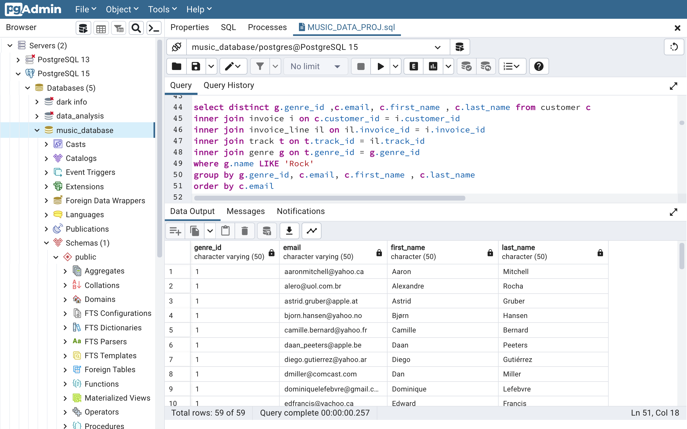
Q6. Write query to return the email, first name, last name, & Genre of all Rock Music listeners. Return your list ordered alphabetically by email starting with A
Answer6. The above query has returned the required information of all rock music listeners.

Slide 12
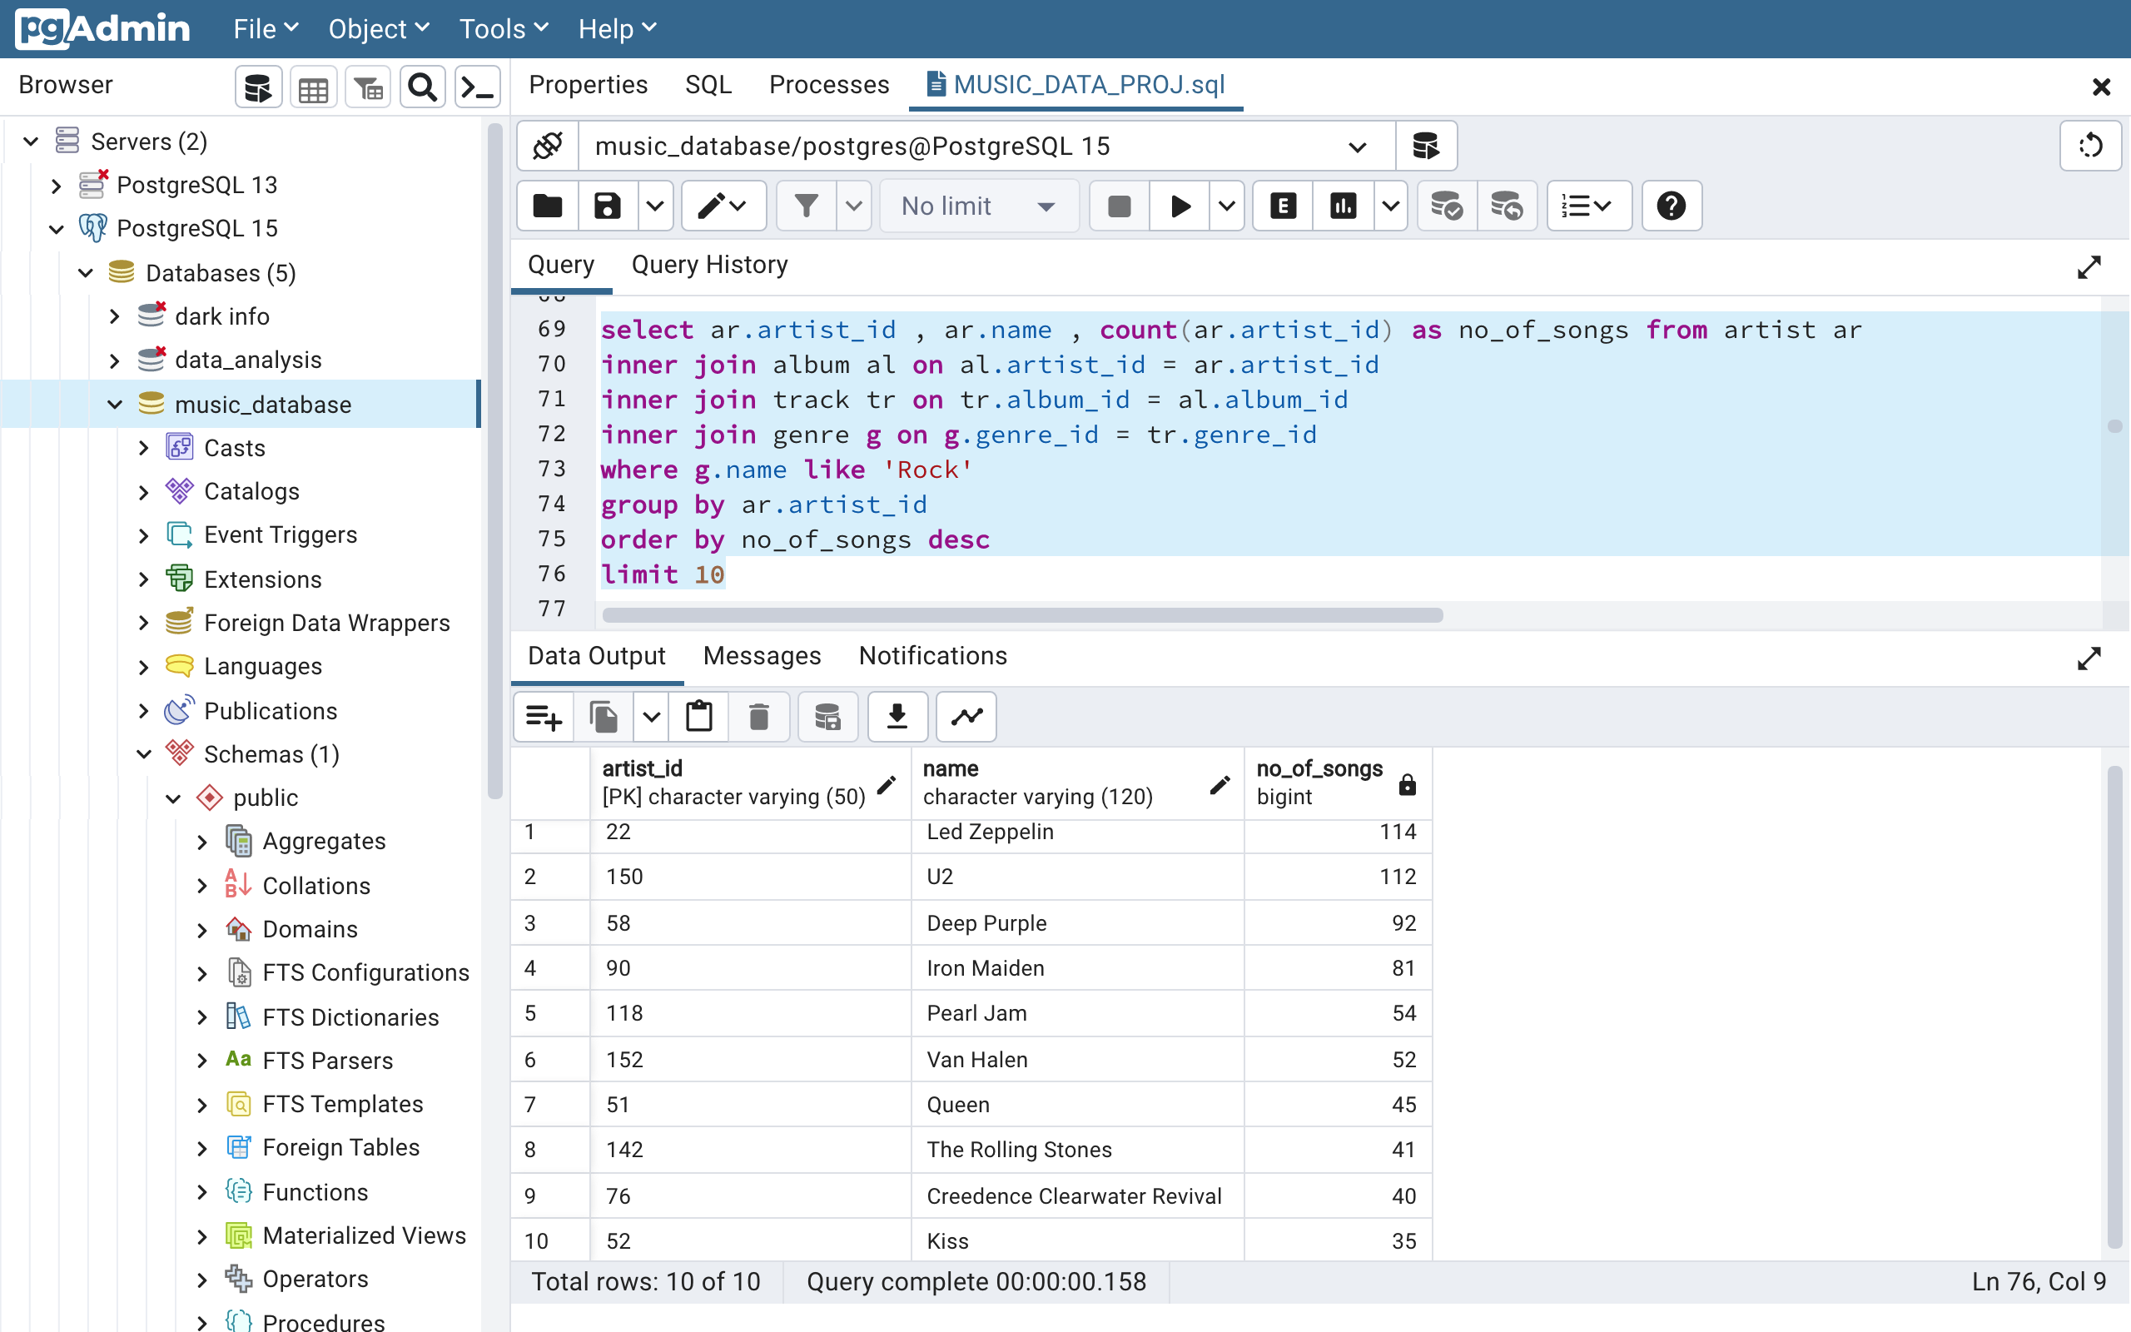
Q7. Let's invite the artists who have written the most rock music in our dataset. Write a query that returns the Artist name and total track count of the top 10 rock bands
Answer7. The above query has returned the artist names and total track counts of top 10 rock bands.

Slide 13
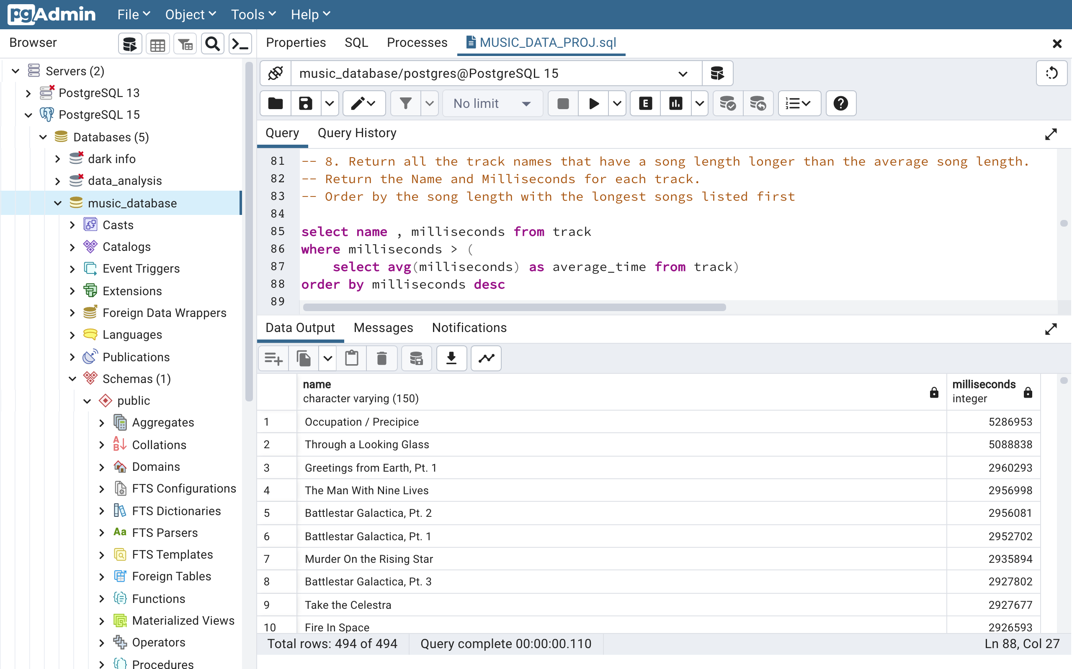
Q8. Return all the track names that have a song length longer than the average song length. Return the Name and Milliseconds for each track.
-- Order by the song length with the longest songs listed first
Answer8. The above query has returned all the track names that have a song length longer than the average song length

Slide 14
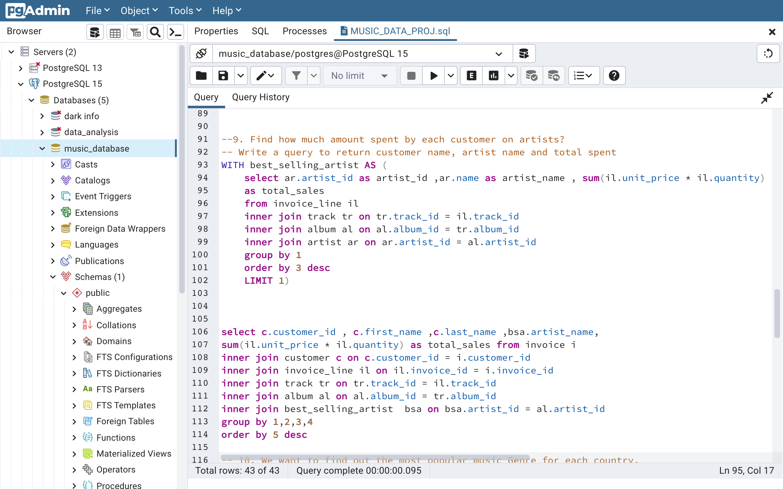
Q9. Find how much amount spent by each customer on artists? Write a query to return customer name, artist name and total spent -- Order by the song length with the longest songs listed first

Slide 15
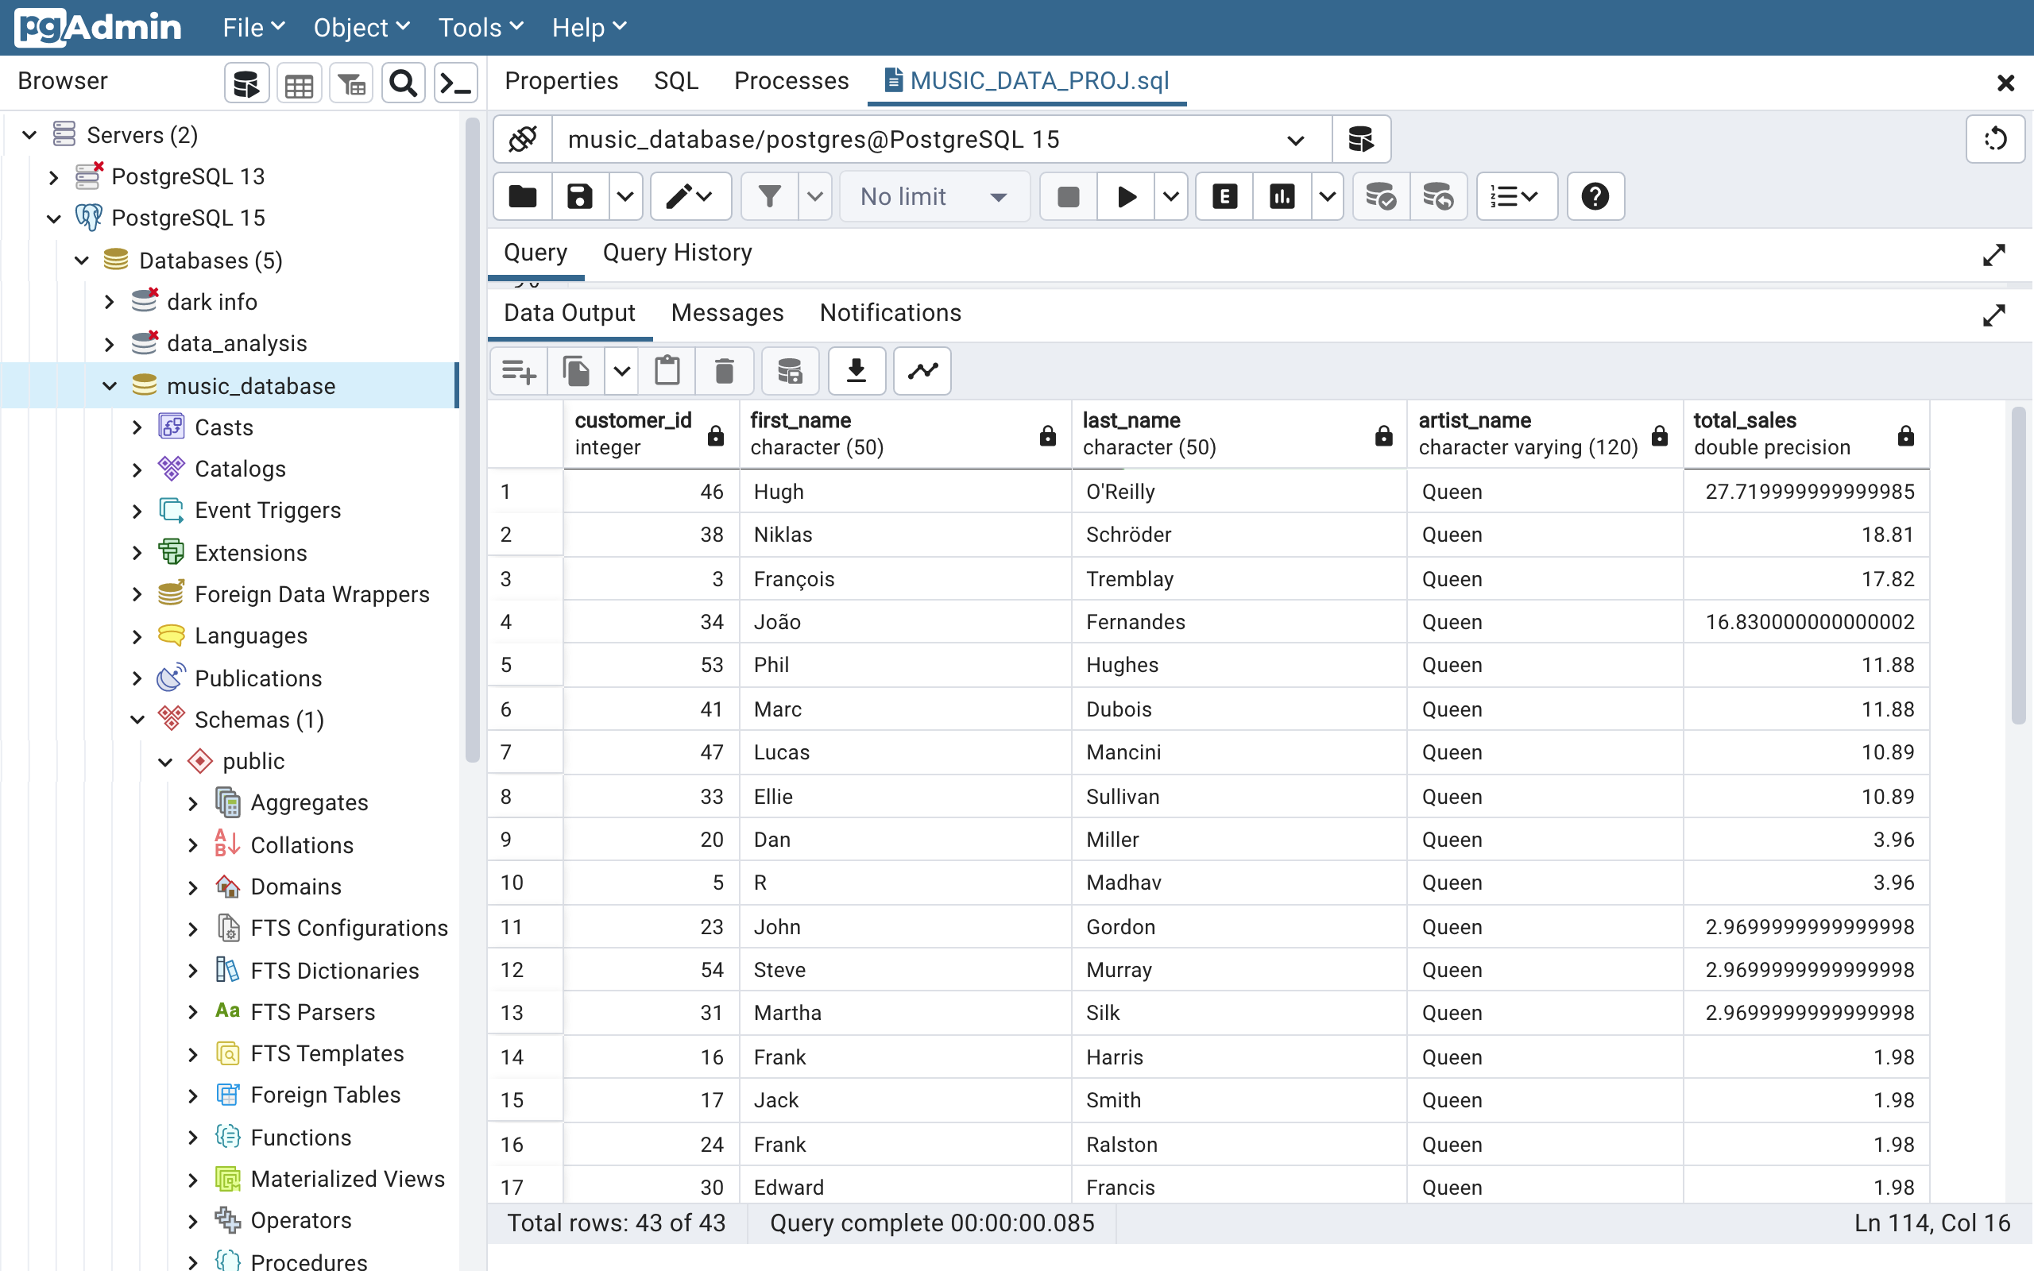
Q9. Find how much amount spent by each customer on artists? Write a query to return customer name, artist name and total spent -- Order by the song length with the longest songs listed first (OUTPUT)
Answer9. The above query has returned all the to return customer name, artist name and total spent.

Slide 16
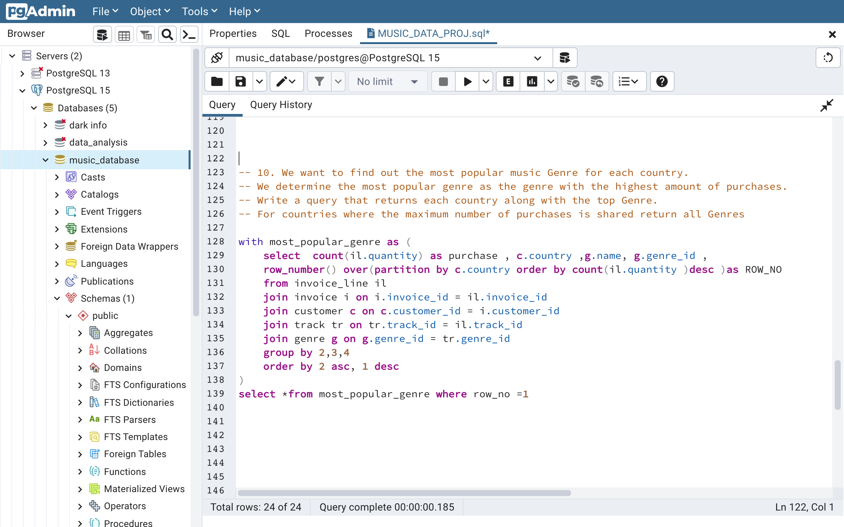
10. We want to find out the most popular music Genre for each country. We determine the most popular genre as the genre with the highest amount of purchases. Write a query that returns each country along with the top Genre. For countries where the maximum number of purchases is shared return all Genres.

Slide 17
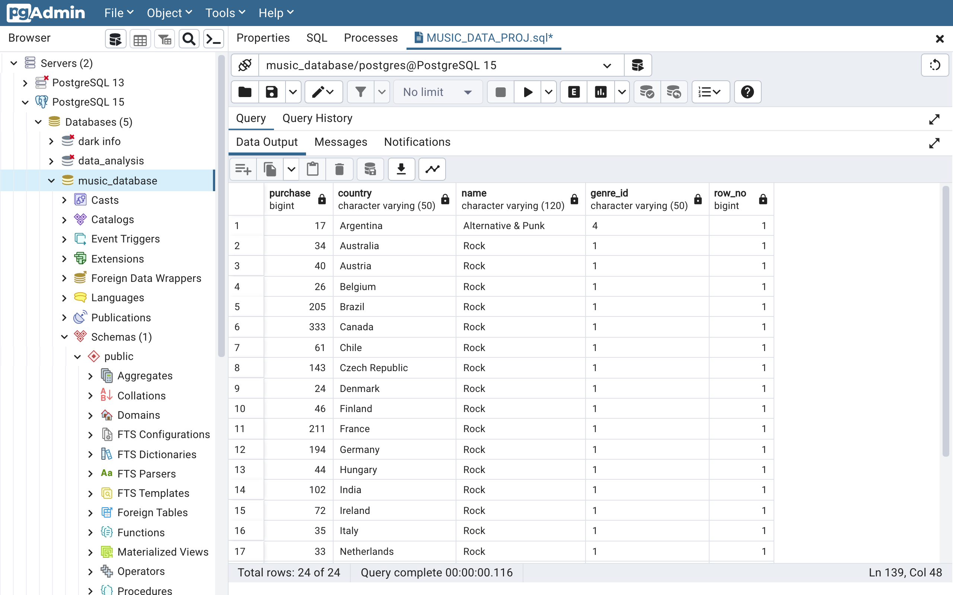
10. We want to find out the most popular music Genre for each country. We determine the most popular genre as the genre with the highest amount of purchases. Write a query that returns each country along with the top Genre. For countries where the maximum number of purchases is shared return all Genres. (OUTPUT)
Answer10. The above query has returned all the to country along with the top Genre and For countries where the maximum number of purchases is shared return all Genres.

Slide 18
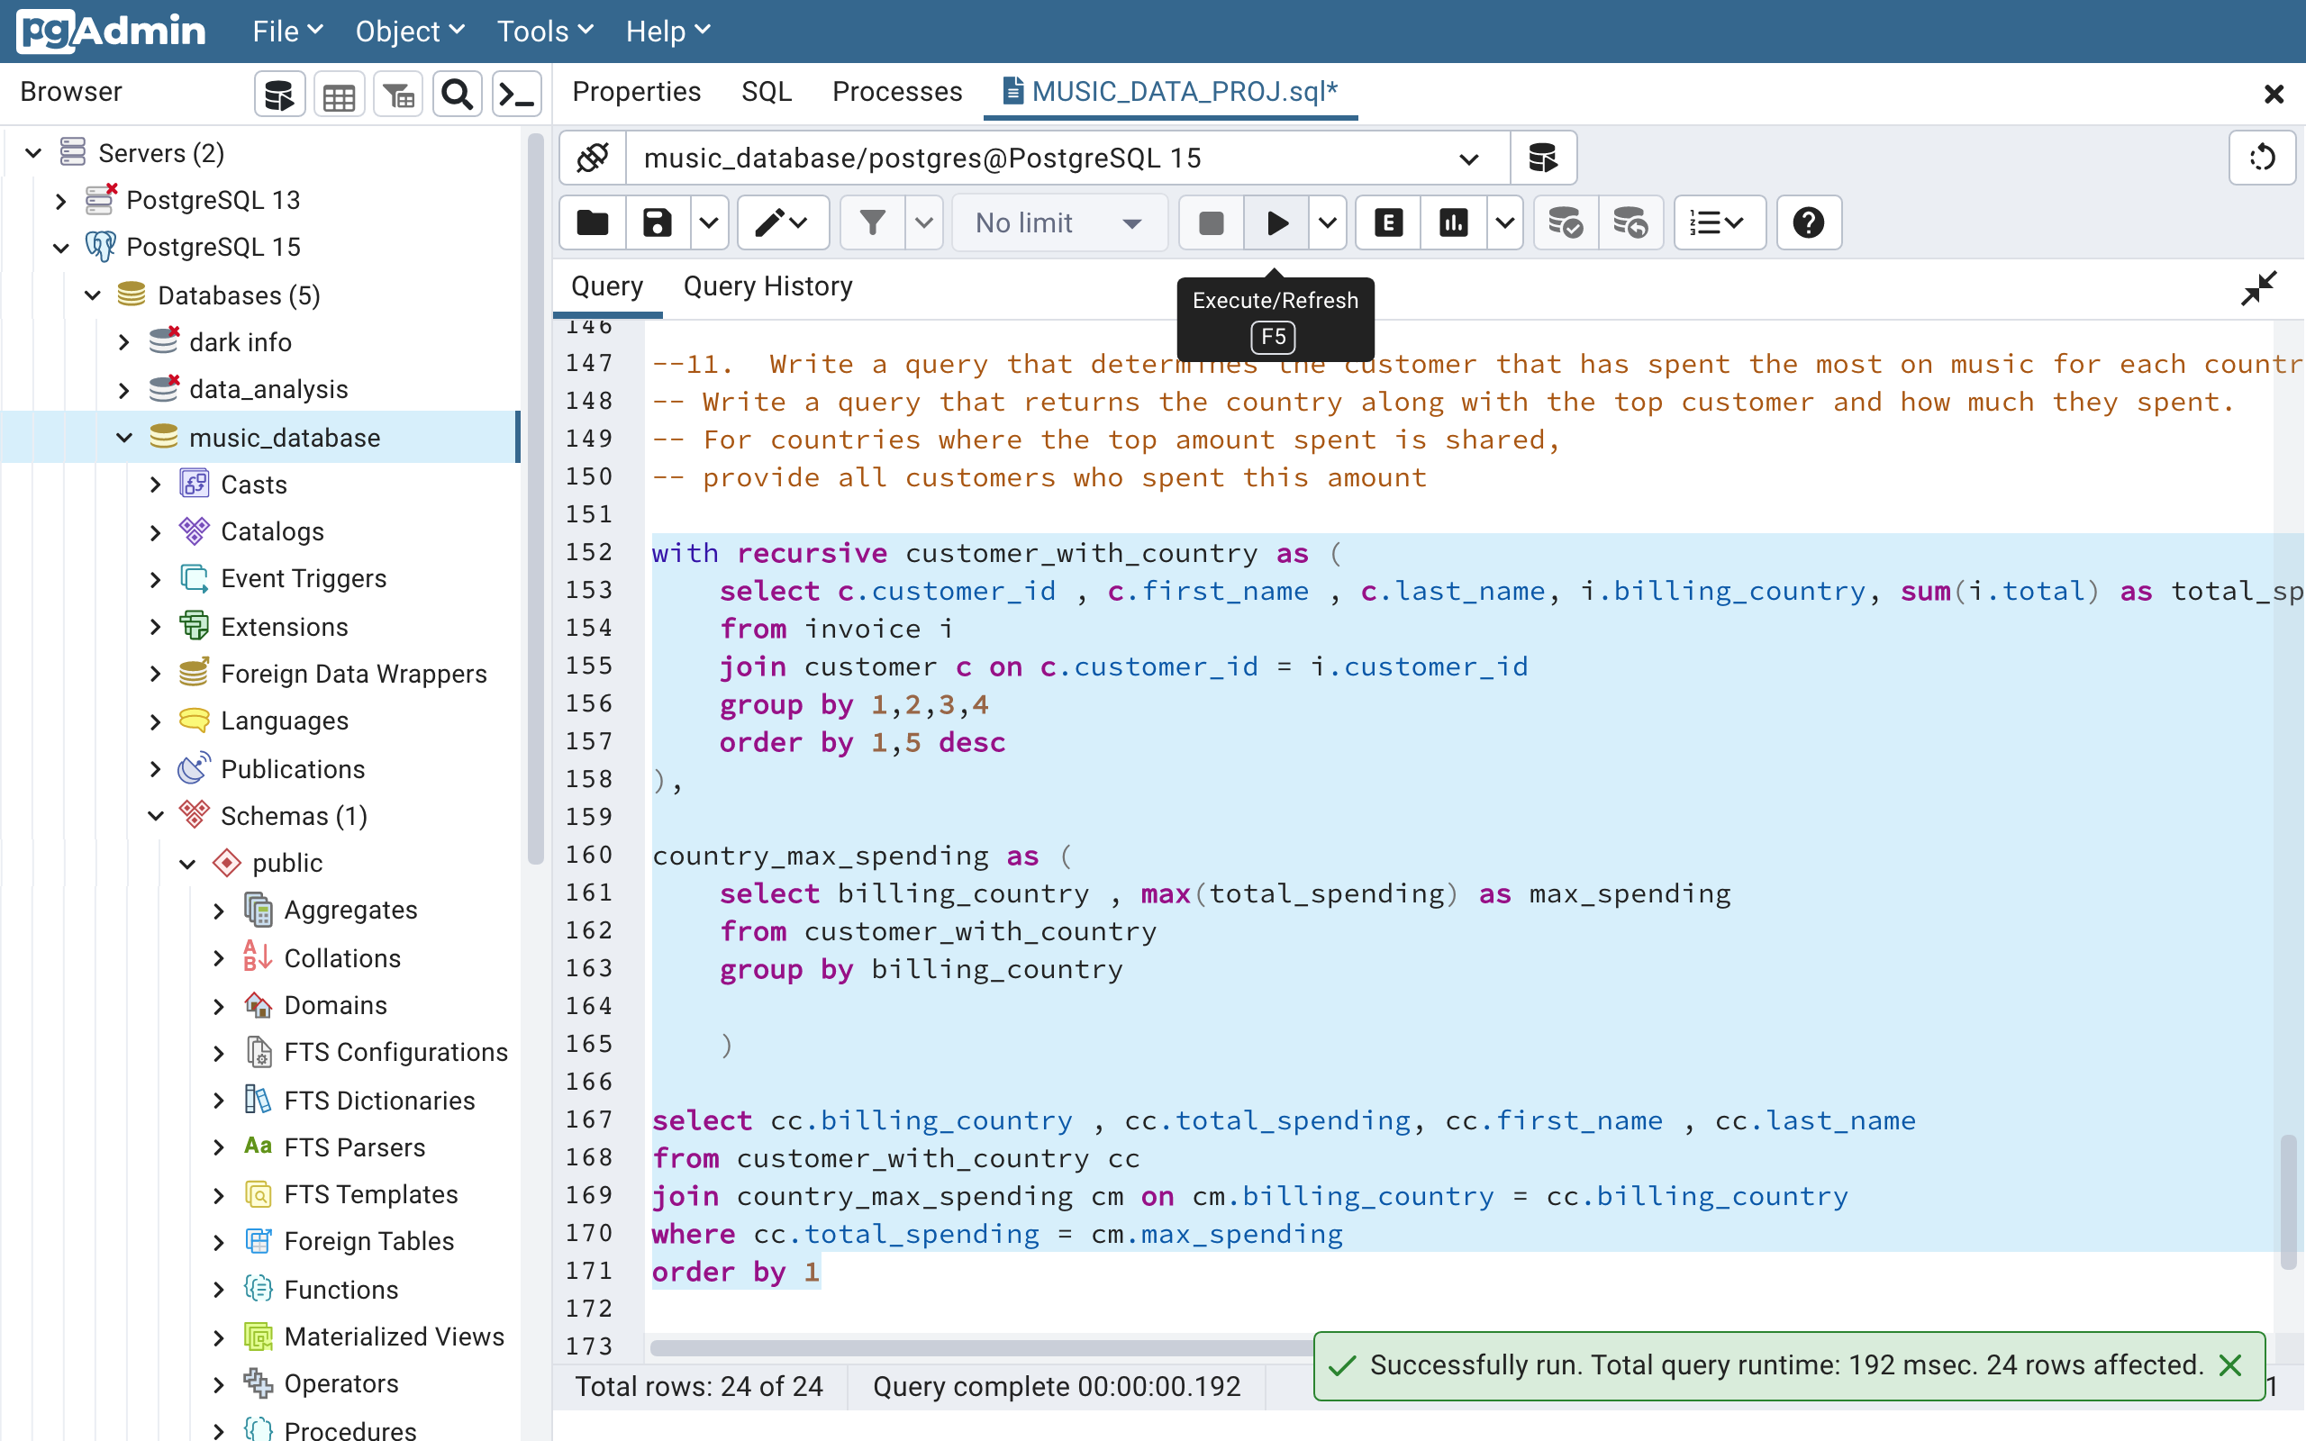
Q11. Write a query that determines the customer that has spent the most on music for each country. Write a query that returns the country along with the top customer and how much they spent. For countries where the top amount spent is shared, provide all customers who spent this amount

Slide 19
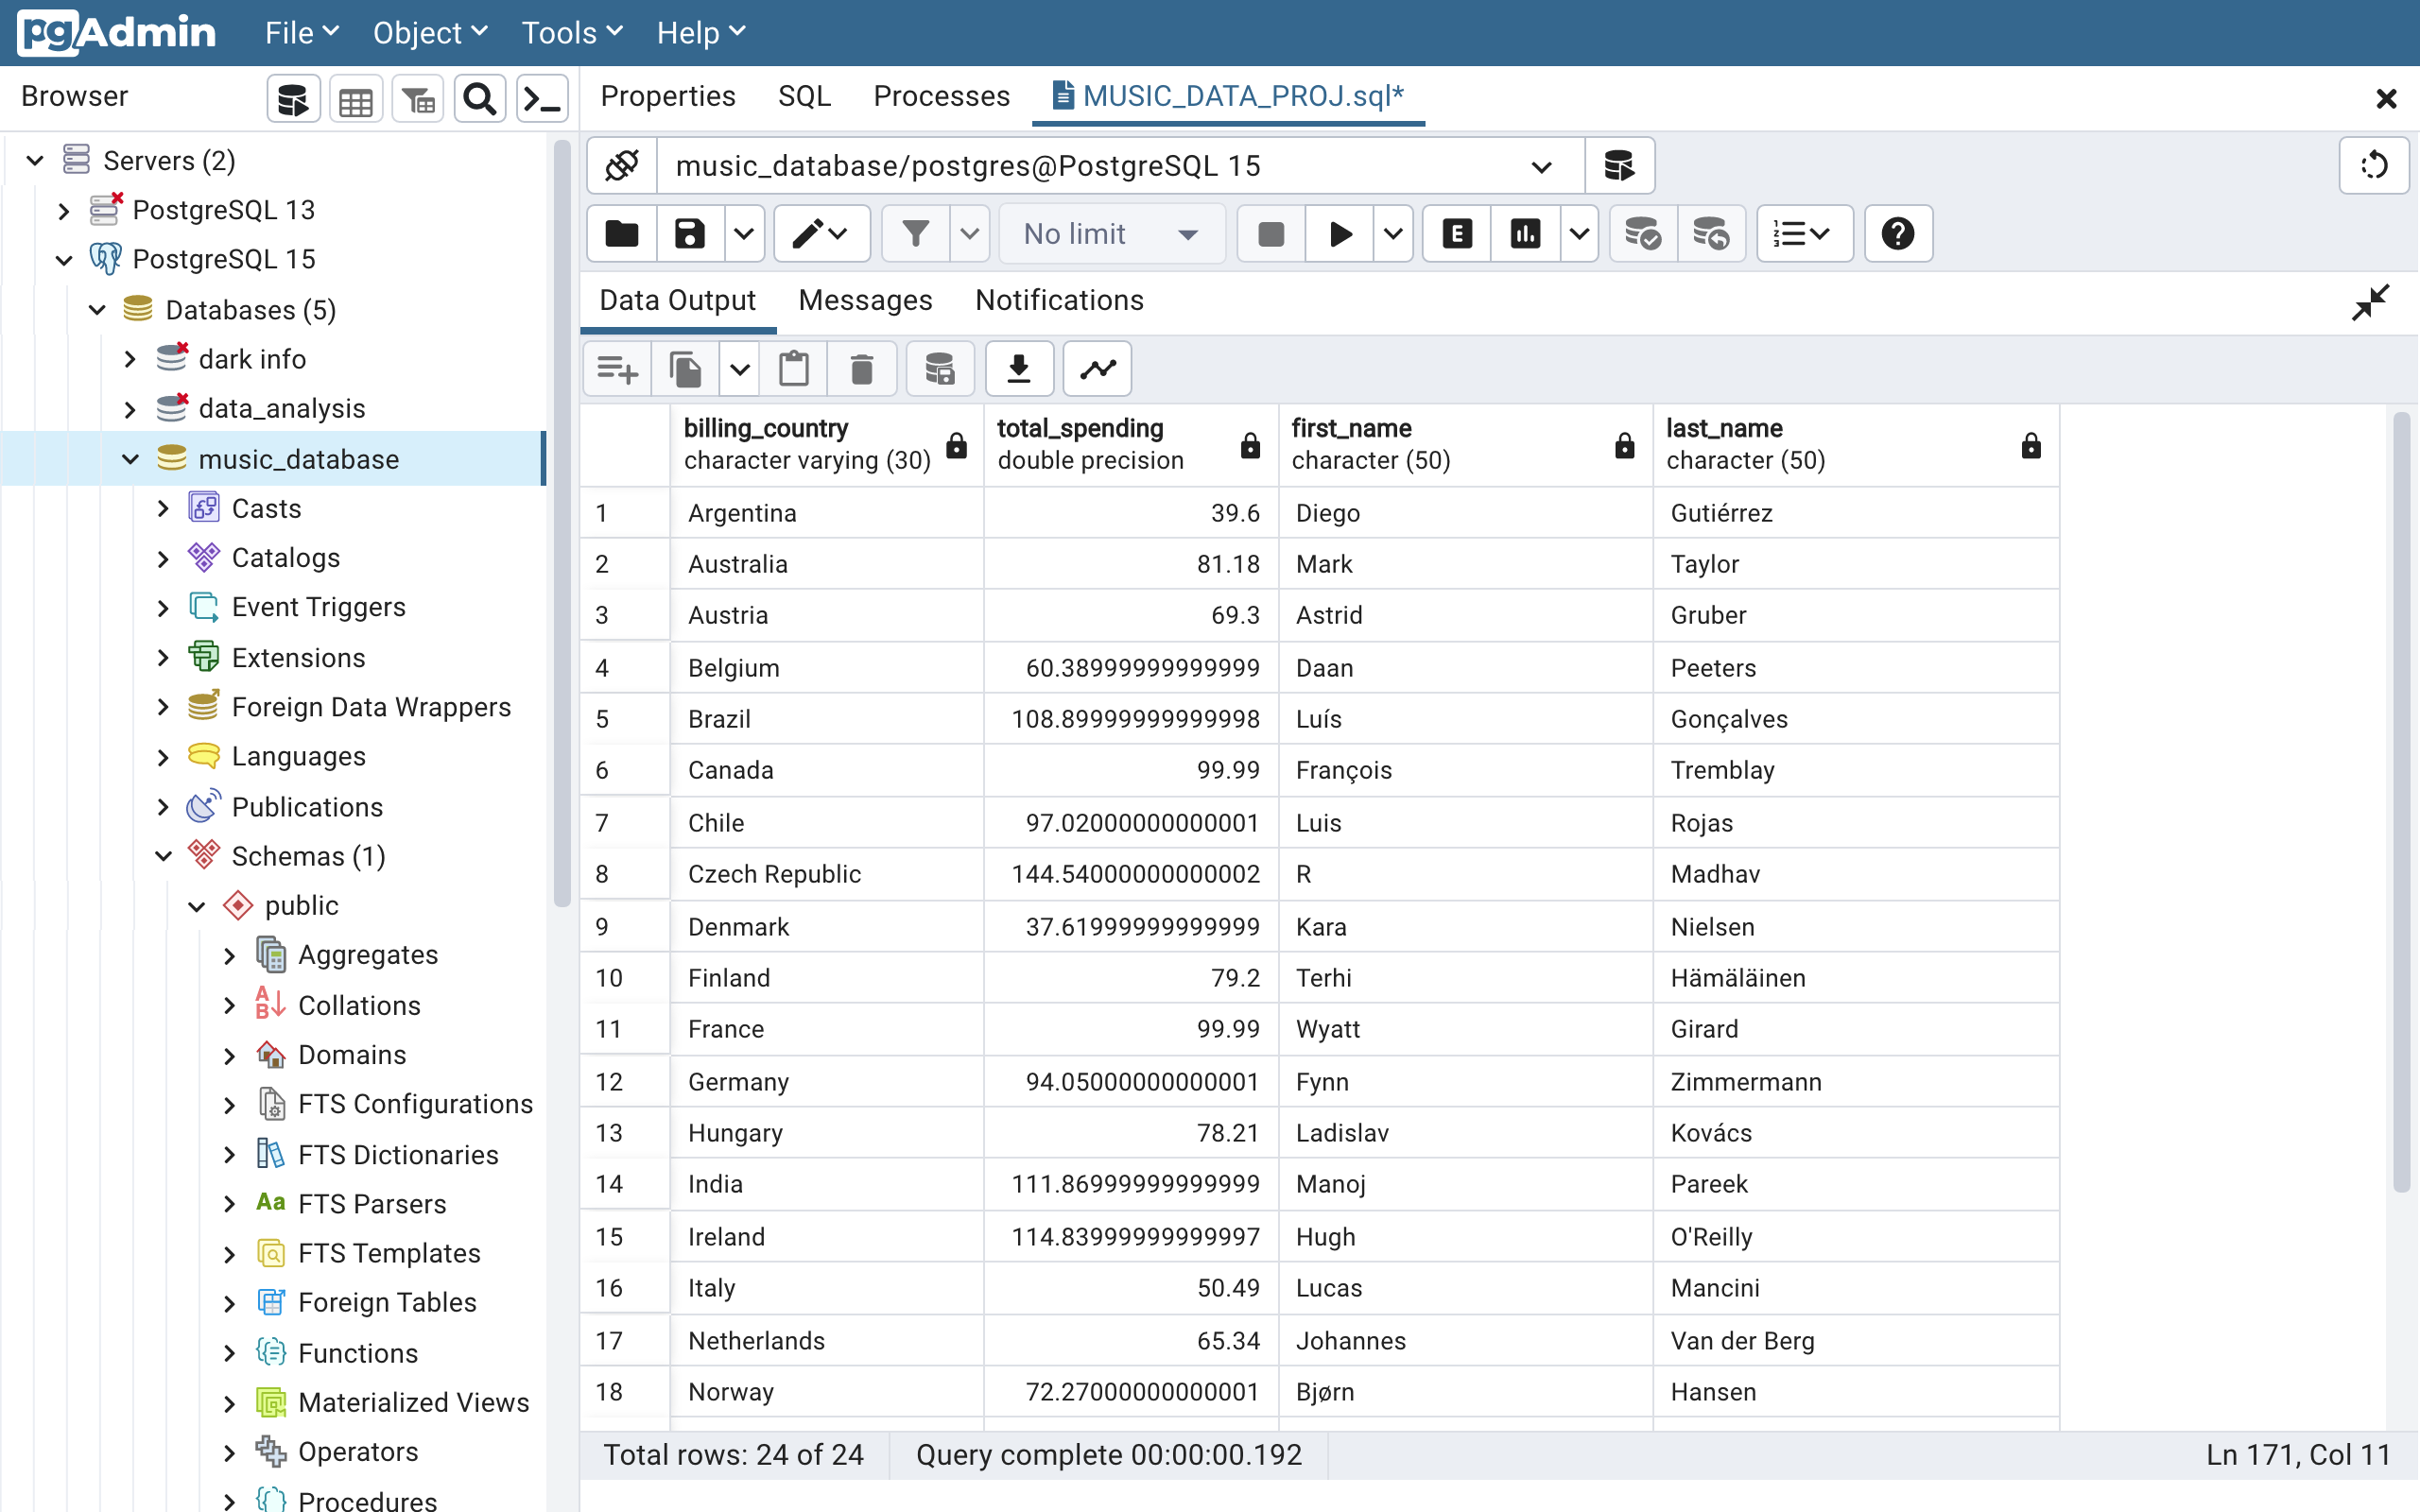
Q11. Write a query that determines the customer that has spent the most on music for each country. Write a query that returns the country along with the top customer and how much they spent. For countries where the top amount spent is shared, provide all customers who spent this amount. (OUTPUT)
Answer11. The above query has returned all the required information form the dataset.

